Slide 1
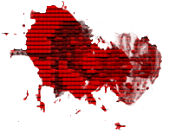
Miami Beach Zombie Apocalypse
By Dishoungh White, Valdimar Sigurdsson, Alaina Edwards, and Gavin Glenn

Slide 2

Overview
Premise: Survive against a horde of zombies
A player would spawn on a spot of a given map and zombies would hunt the player down
To win, shoot down all the zombies in the area and survive
Story: A deadly zombie infection has hit Miami. This outbreak is likely spread by a new, popular strain of cannabis commonly known as “The Zomb”. Within days of inhalation, this highly dangerous strain causes the subjects to enter a permanent state of primal rage but slow movement. You do what you must to survive.

Slide 3

Process Model
Model we chose: Scrum Agile
Why?
Risk control
Flexibility
Allows for more creativity in our project
We divided our project into 5 stages and we would meet in person every Saturday to demo our progress and we would converse everyday in a Discord server.

Slide 4
The 5 Stages of Our Project
Stage I: Requirement Analysis
Find out what kind of game we wanted to make
Stage II: Designing the Map and Game Object Placement
Design the map and design the type of objects to place in our map
Stage III: Implementing More Features
Optimize the map from stage II, skin the player/zombie objects, player movement and make the game’s soundtrack
Stage IV: Final Features and Optimization
Implement player health, zombie movement, create pause feature, and optimize the previous features for demonstration
Stage V: Testing
Test the final demo of the game and document bugs

Slide 5


Stage I: Requirement Analysis
We wanted to make a game, which is something we were all familiar with
The game we wanted to make had to:
Obviously have a player and zombie objects
Each of those objects should move around the map
Zombies hunt down the player when nearby
Have a mouse controlling the player’s aim and shooting.
Set our game in one giant map to place all of our game objects
Create an audio player for our music and gunshots
Pause whenever the user wishes to and stop the game whenever the player “dies”
After we set up our requirements for our game, we devised a schedule for the end of each stage.

Slide 6

Stage II: Designing the Map and Game Objects
It would be difficult for us to design a map by hand with the code.
To make it easier, we designed the map using an image file and the game would load in the image file and place certain objects in accordance to the pixel color.
Red would mean place a block (wall) at the pixel’s location
Blue would mean place the player at the pixel’s location
Green would mean place a zombie at the pixel’s location

Slide 7
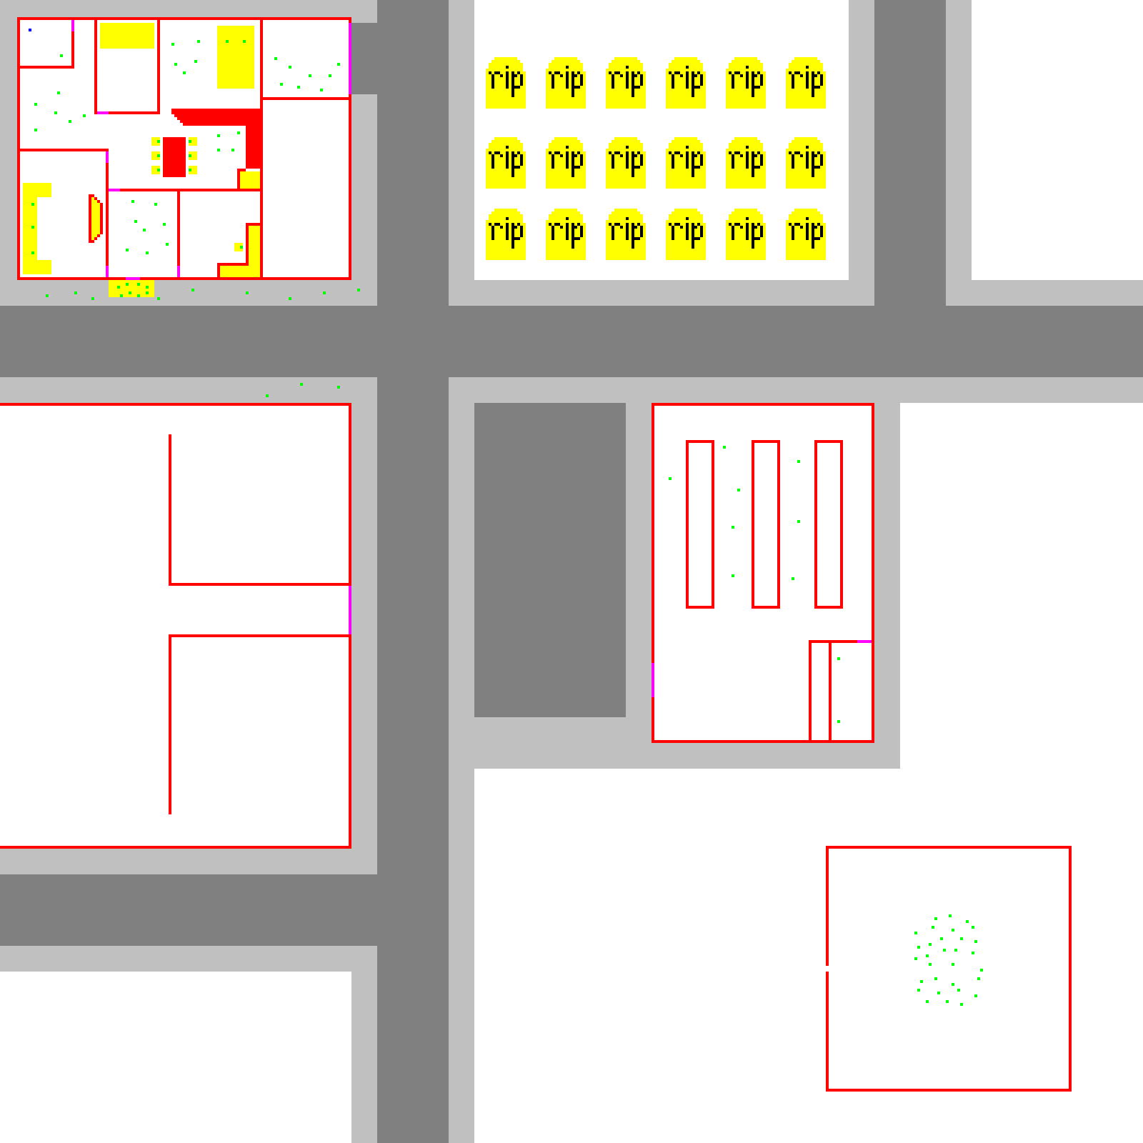

The Map

Slide 8

Stage III: Implementing More Features
By Stage II, we had a solid framework for our game
We continued to polish up our game by:
Adding more to our map
Designing a character model for our player and zombies
Moving the player with the WASD keys
Create the audio player for the game’s soundtrack and gunshots

Slide 9

Stage IV: Final Features and Optimization
After Stage III, we were almost finished with our game
All we had left was to:
Add a health attribute to our player and zombie objects
Design the zombies to hunt for the player
Pause the game whenever the user presses the pause key
Add a “Game Over” screen whenever the player’s health runs out

Slide 10



Stage V: Testing
For the final days before the demo, we wanted to test our game and hunt for bugs
Bugs Found:
Zombies don’t rotate when moving
Zombies all move in a line
Player’s health doesn’t decrement as long as player is standing still
Bullet doesn’t come out from gun all the time

Slide 11
Stage V: Testing (Cont.)
White Box Testing
To make sure our designs worked, we looked at our code and tested our individual parts and made sure it behaved and functioned as intended
Regressional Testing
After every stage of development, we would merge our parts into the master branch in Github and tested the merged version to minimize additional bugs into our game
Performance Testing
We tested our game to ensure the game would be thread-safe and our game would maintain a stable framerate in our test environment

Slide 12

Software Used
Language: Java
Map Creation: Tiled
IDE: Eclipse
Version Control: Git
Audio File Conversion: FFMPEG

